Slide 1
Rideshare Simulation and Analysis: Uber & Lyft
Aaliya Merchant, Nikhil Prabhu, Shiraz Rehmani

Slide 2
Problem Statement
The objective is to analyze rideshare data from Uber and Lyft to understand key trends and behaviors.
The analysis focuses on key metrics such as:
Ride distribution (Uber vs. Lyft)
Price trends
Ride cancellations
weather, volume, and ride type
The goal is to simulate real-world conditions of rides, including cancellations, pricing adjustments, and the impact of weather and time of day on ride completion and pricing.
Notes:
Ride-sharing services such as Uber and Lyft have become integral to urban transportation, offering convenience and affordability to users while providing flexible income opportunities for drivers. However, managing the complexities of ride requests, cancellations, driver availability, and ride durations presents a significant challenge for these platforms. Understanding how external factors such as weather and surge pricing influence operational dynamics is critical for improving resource allocation, customer satisfaction, and pricing strategies.

Slide 3
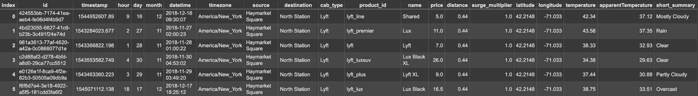
Dataset Description
The dataset contains detailed rideshare information from Uber and Lyft, including both ride and environmental data:
Source: The dataset is sourced from Kaggle’s Rideshare dataset, which is used to simulate real-world rides and analyze rideshare trends.
Notes:
This dataset provides detailed information from Uber and Lyft rides specifically in Boston, Massachusetts, combining ride-specific details like price and distance with environmental factors such as weather conditions—temperature, humidity, and precipitation. This data was captured during the months of November and December. It’s sourced from Kaggle’s Rideshare dataset, designed to simulate real-world rideshare patterns and analyze trends. We’ll use this data to simulate rideshares and explore how various factors influence pricing and demand in the rideshare industry.

Slide 4
Methodology Overview
Exploratory Data Analysis (EDA):
Analyzing the distribution of ride types (Uber vs. Lyft).
Analyzing price and distance trends to understand the distribution.
Visualizing the correlation between ride prices and weather conditions (temperature, humidity, etc.).
Simulation:
The simulation is built using SimPy, a Python library used for event-driven simulations.
Key Events Simulated:
Ride cancellations based on factors such as distance, weather, and time of day, total ride requests.
Price adjustments based on dynamic weather conditions and ride type and total ride requests.
Notes:
First, we conducted an Exploratory Data Analysis to understand the dataset. This included comparing ride types between Uber and Lyft, analyzing price and distance trends, and examining correlations between ride prices and weather conditions like temperature and humidity.
Next, we built a simulation using SimPy, a Python library for event-driven simulations. The simulation focused on two key aspects:
Ride cancellations influenced by factors like distance, weather, and time of day.
Dynamic price adjustments based on weather, ride type, and total ride requests.
This approach helps us model real-world rideshare behavior and explore the impact of external variables on trends and outcomes.

Slide 5
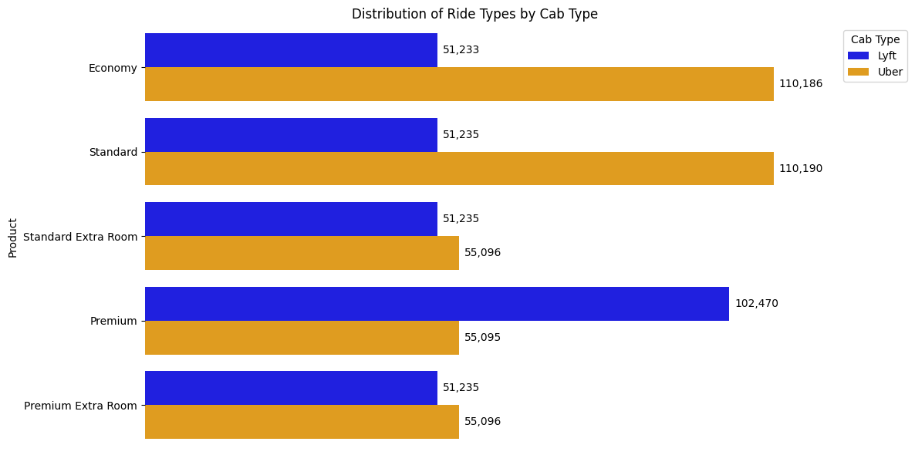
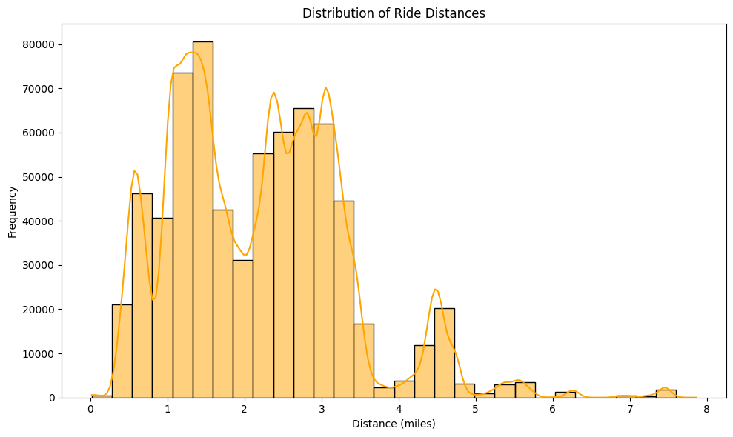
EDA Results – Ride Distribution
 | Total Rides | Average Distance
Uber | 385,663 | 2.19
Lyft | 307,408 | 2.19
Notes:
We first examined the total ride distribution by Uber and Lyft as well as the average distance travelled per ride.While both the companies have the same average distance per ride, Uber had more total rides at 385,663 compared to 307,408 for Lyft.
Next we looked at distribution of rides by categories. As can be seen, Lyft riders tend to choose higher end categories (Premium) while Uber generally catered to more economy options and had a more even distribution across all the remaining categories.
The distribution of ride distances shows that distance travelled peaks between 1 - 3 miles indicating shorter rides are more common. This does confirm with the source of data being from Boston MA as we expect shorter rides within city limits.

Slide 6
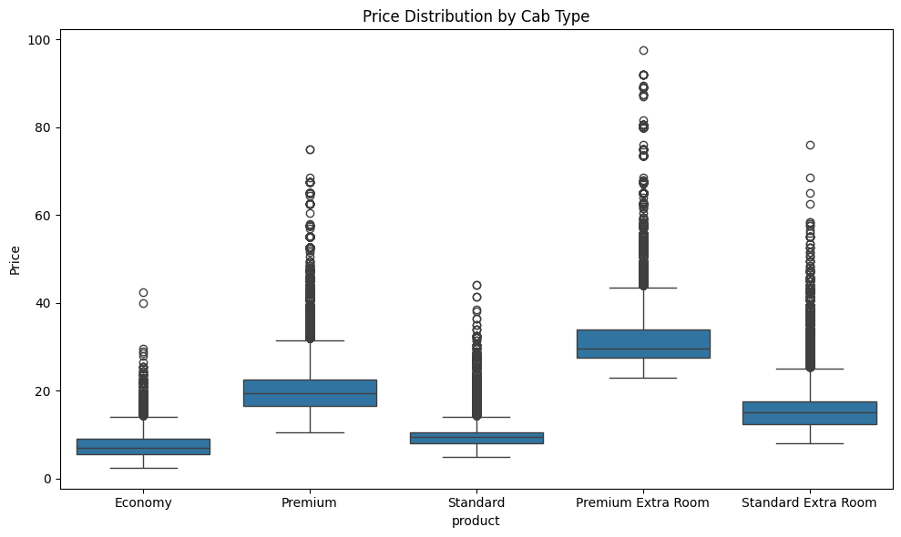
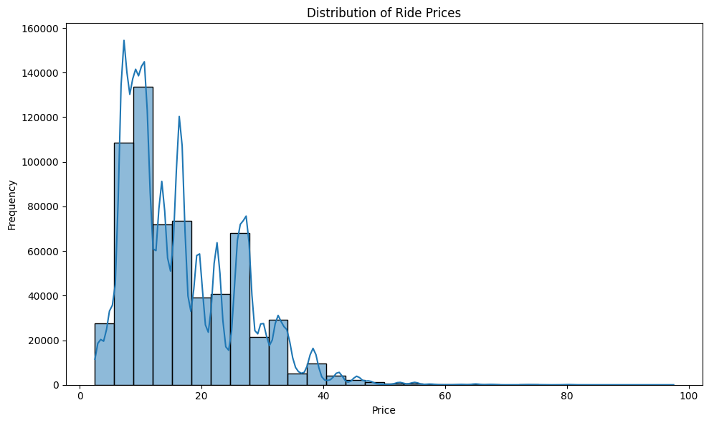
EDA Results – Ride Prices
Average Price for Uber: $15.80
Average Price for Lyft: $17.35
Ride Category | Uber Prices | Lyft Prices
Economy | $8.75 | $6.03
Premium | $20.52 | $20.42
Standard | $9.77 | $9.61
Premium Extra Room | $30.29 | $32.32
Standard Extra Room | $15.68 | $15.31
Notes:
We started by examining the ride prices of Lyft and Uber. We first improved and standardized the raw data into comparable categories. We then evaluated average prices by these ride categories and looked at their overall distribution.
The overall average price for Uber was $15.80 while for Lyft was slightly higher at $17.35. Overall Lyft is more cost effective than Uber on all categories except Premium where both companies have a similar pricing structure with Lyft at $20.42 and Uber at $20.52. And as we saw previous slide, Lyft customer tend to favor more higher end ride options.
The box plots show the price variability within each of these categories - we can observe significant fluctuations in prices seemingly due to conditions such a time of day, pickup and drop of locations and demand surges.
Lastly the histogram depicts the overall distribution of ride prices with a major concentration of rides in the lower price ranges confirming the shorter distances from the previous slide.

Slide 7
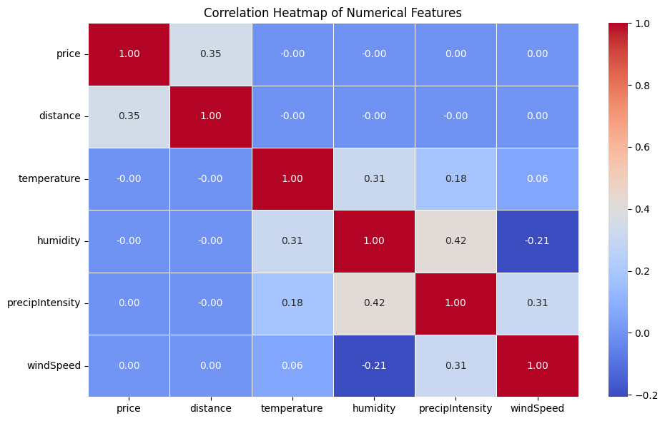
EDA Results – Weather Patterns
Distance moderately influences price (r=0.35).
Strong interdependence between weather factors:
Temperature and Humidity (r=0.31).
Humidity and Precipitation Intensity (r=0.42).
Price shows weak correlation with weather variables, indicating limited direct impact.
Notes:
Next we evaluated the relationship between weather and ride prices by conducting a correlation analysis based on numerous weather variables and ride price.
The correlation between:
Ride Prices and Distance is moderate indicating that as distance increases, price too tend to increase
Weather shows a weaker correlation with ride prices implying that it has limited direct impact on ride prices.
As expected weather variables have stronger interdependence.
This analysis is important as it helps us understand what factors are influencing ride prices and how to model them in our simulation design.

Slide 8
Simulation Design
SimPy is used to simulate real-world conditions affecting rides.
The system models events like ride cancellations, price adjustments, and driver availability.
Cancellation Logic: Rides are canceled if certain conditions are met, such as:
Long ride distances, high weather impacts, or peak hours.
Price Adjustments: Prices change dynamically based on:
Weather conditions (e.g., rain increases prices).
Ride type (premium ride types have higher prices).
Testing Different Data Subsets:
The simulation is tested on three subsets of the data for comparison:
200 rides: To test the basic functionality of the system.
400 rides: To observe scalability and performance.
600 rides: To analyze system behavior with a larger dataset and more complex dynamics.
Notes:
The system simulates real-world conditions by checking if a ride should be canceled due to factors like long distances (over 50 miles), poor weather (rain or snow), or peak hours (5 PM to 8 PM). It also adjusts prices based on the weather and ride type, with premium rides costing more, and increases during bad weather. Finally, the system simulates driver availability, where each ride has a 90% chance of a driver being available.
The simulation process begins reading in a data frame that includes distance, weather, ride type, and time of day. Based on this, the system checks cancellation conditions, verifies driver availability, and calculates the ride price. If the ride is not canceled, the system simulates the ride duration using SimPy's timeout function, representing real-world travel time.
We test the system with different ride counts: 200 rides for basic functionality, 400 rides for scalability, and 600 rides to analyze system behavior under load.

Slide 9
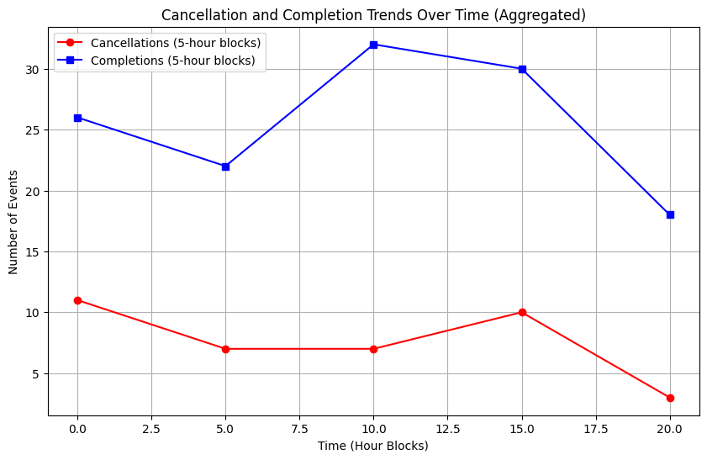
Simulation Results
200 Ride Simulation
Completions:
Ride completions started at 26 events during the 1st hour and dipped to 22 events
Ride completions peak at 35 events during the 10th hour block, indicating high midday demand.
Cancellations:
Remain consistently low throughout the day, starting at 11 events in the first 5 hours,
dipping closer to 5 events in the 5th to 10th hour block,
Slightly rising to 10 events by the 15th hour block.
Dipped during 15th hour to 20th hour
Pricing:
Uber Average Price: $20.47
Lyft Average Price: $21.50
Notes:
The graph titled "Cancellation and Completion Trends Over Time (Aggregated)" displays the number of cancellations and completions over a 20-hour period, divided into 5-hour blocks. The red line represents cancellations, and the blue line represents completions.
Cancellation rates start high and gradually decrease over time, with a slight increase around the 10-hour mark. This initial peak could be attributed to various factors like scheduling conflicts or unexpected events. The subsequent decrease might indicate better planning or a reduced need for services.
Completion rates initially decrease, reaching a high point around the 10-hour mark. This could be due to a period of adjustment or resource allocation. However, completions start to decrease significantly, reaching a peak around the 10-hour mark, before decreasing again towards the end. This peak might be related to a specific event or deadline. The final decrease could be due to a decrease in demand or resource availability.

Slide 10
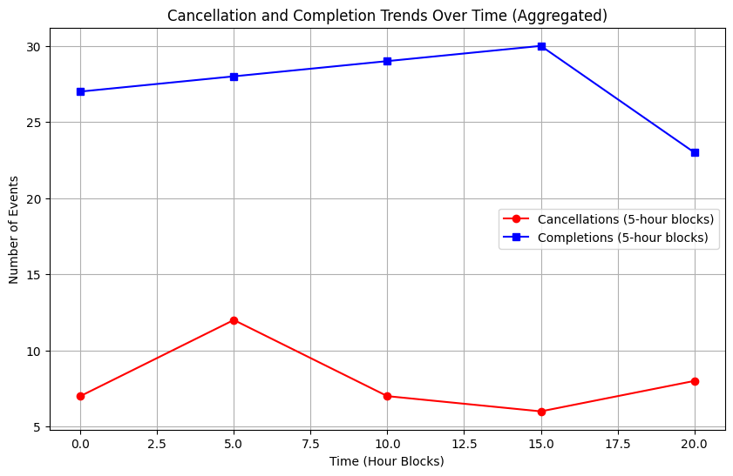
Simulation Results
400 Ride Simulation
Completions:
Ride completions peak at 30 events during the 15th hour block, indicating high midday demand.
Lowest completion was at the 20th hour
Cancellations:
Remained low at the beginning of events but peaked during the 5-hour mark,
Remained constantly low during the other
and slightly rising to 8 events by the 15th hour block.
Pricing:
Uber Average Price: $18.86
Lyft Average Price: $22.69
Notes:
Cancellation rates start high and gradually decrease over time, with a slight increase around the 5-hour mark. This initial peak could be attributed to various factors like scheduling conflicts or unexpected events. The subsequent decrease might indicate better planning or a reduced need for services.
Completion rates initially increase, reaching a high point around the 15-hour mark. This could be due to a period of adjustment or resource allocation. However, completions then decrease significantly, reaching 23 rides.

Slide 11
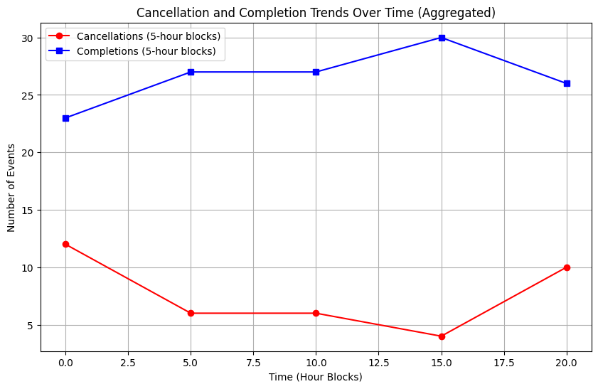
Simulation Results
600 Ride Simulation
Completions:
Ride completions peak at 30 events during the 15th hour block, indicating high midday demand.
Cancellations:
Peaked at the beginning at 13 events
Dipped down from the 5th hour and rose during the 15th to 20th hour
Pricing:
Uber Average Price: $20.39
Lyft Average Price: $22.03
Notes:
The graph shows that cancellations and completions exhibit different trends over time. Cancellations start relatively high and decrease gradually, with a increase around the 15th to 20 hour mark. The subsequent decrease might indicate better planning or a reduced need for services.
In contrast, completion rates remain relatively stable throughout the period, with a slight increase around the 10-hour mark. This could indicate a consistent level of demand or resource allocation, with a possible surge in activity during the 10-hour period.
The three graphs presented show the number of cancellations and completions over a 20-hour period, divided into 5-hour blocks. In Graphs 1 and 3, both cancellation and completion rates exhibit similar trends. Cancellations start high and gradually decrease. This could be due to factors like initial adjustments or unexpected events. Completions initially decrease, likely due to resource allocation or prioritization, but then increase significantly around the 10-hour mark, possibly related to a specific event or increased demand. In contrast, Graph 2 shows a more stable trend for both cancellations and completions. Cancellation rates remain relatively constant, while completion rates have a slight increase until around the 15th hour mark, possibly due to the resource allocation during that period.

Slide 12
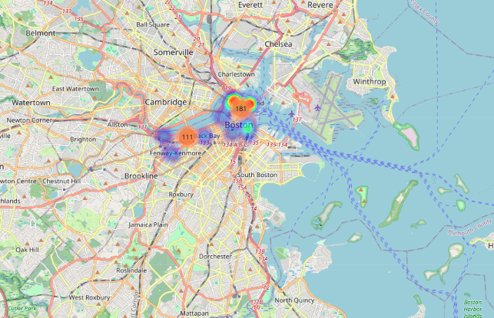
Ride Simulation Demo
Notes:
This Python code generates an interactive map using the Folium library to visualize ride data. It overlays markers on a map, each representing a ride event. The markers are color-coded based on weather conditions, and clicking on a marker displays details like ride ID, cab type, product, price, weather, and status. Additionally, a heatmap is added to show the concentration of higher-priced rides. A colormap legend is included to explain the weather condition color coding. This map provides a comprehensive visual representation of ride data, allowing for analysis of trends related to weather, location, and pricing.

Slide 13
Real-World Implications
Ride Cancellations:
High cancellation rates can lead to customer dissatisfaction. Understanding these factors helps minimize disruptions.
Price Adjustments:
Dynamic pricing mechanisms are essential for balancing supply and demand, especially during peak hours or adverse weather.
Customer Experience:
Analyzing customer feedback and ride experiencing helps improve service quality and satisfaction.
Notes:
The analysis and simulation of is applicable in the real world as it may provide actionable insights that can lead to improved service efficiency, customer satisfaction and customer experience.
For example:
Ride cancellations often correlate with customer dissatisfaction. By examining the trends of our simulation we can identify key factors that contribute to ride cancellations and attempt to develop strategies to address them.
Price Adjustments could be a critical tool to proactively predict and manage supply (drivers) and demand (riders) effectively. Prices can be adjusted during peak times or bad weather conditions to bring better balance to the system without hurting ride/driver availability.
Lastly, the simulation could provide useful insights based on Customer feedback to refine overall service quality and ensure a high level of customer satisfaction.

Slide 14
Conclusion and Future Work
Conclusion:
The simulation provides valuable insights into ride completions, cancellations, and pricing.
Future Work:
Extend the model to include more real-world factors (e.g., traffic, time of day).
Optimize the model to handle larger datasets and real-time applications.
Explore the integration of machine learning models to predict ride success and dynamically adjust prices.
Notes:
In conclusion, the simulation offers key insights into how factors like weather and distance impact ride completions, cancellations, and pricing. It’s a simplified but effective model of real-world rideshare dynamics.
Looking ahead, future work could extend the model by incorporating additional real-world factors like traffic and time of day. Another area for improvement is optimizing the simulation to handle larger datasets and even real-time applications. Finally, integrating machine learning models could enhance predictions for ride success and enable dynamic price adjustments based on real-time data.

Slide 15
Thank You!

